Slide 1

Team Details
Team name: Ice Breakers
Team leader name: Mangipudi V N S Aishwarya
Problem Statement: Signal Extraction from Market & News Data

Slide 2
Brief about the idea
Unifying Data Streams: Ingesting high-velocity, structured market data (stock prices) and high-volume, unstructured news data in real-time.
Extracting AI-Powered Signals: Applying Snowflake Cortex AI for Natural Language Processing (NLP) and sentiment analysis on the news to generate new, predictive features ("AI-derived market sentiment").
Rigorous Validation (Back testing): Using a sophisticated Snowpark-based framework to backtest trading strategies based on the combined technical and AI signals.
Enabling Explainability: Creating a clear data lineage that links every executed trade signal back to the specific market pattern or news article that triggered it, moving from a "black box" to a transparent system

Slide 3
Opportunities
How different is it from any of the other existing ideas?
It unifies advanced AI/NLP processing with high-performance financial computation entirely within a single data platform (Snowflake), moving beyond fragmented, latency-prone systems that separate data analysis from strategy validation.
How will it be able to solve the problem?
It solves the problem of information overload and black-box trading by converting two previously separate, complex data streams (market prices and news text) into one coherent, actionable, and quantifiable signal, which is then linked directly to its source for Explainable AI (XAI).
USP of the proposed solution
The Unique Selling Proposition (USP) is its Audit-Ready, Explainable Trading (XAI) capability, providing end-to-end transparency by linking every simulated trade back to the specific news headline or market event that triggered it.

Slide 4
List of features oﬀered by the solution
Advanced Portfolio Risk Metrics: The Snowpark backtesting framework is extended to calculate and report sophisticated, portfolio-level risk metrics like Value-at-Risk (VaR) and CVaR.
Mock Real-Time Trading: A Snowflake External Function is set up to enable a paper-trading mode, streaming mock execution results back into the system for near-real-time performance monitoring.
Snowpark ML-Based Anomaly Detection: We use Snowpark ML to cluster news and detect sudden, atypical shifts in market narrative using sentiment anomaly detection.
Time-Constraint Enforcement: Snowflake Dynamic Tables are utilized to automatically enforce strict time-travel logic, mitigating look-ahead bias during feature generation for accurate backtesting.
Cortex News Summarization: The Snowflake Cortex SUMMARIZE() function generates a concise, readable summary of the triggering news articles, dramatically improving the explainability feature.

Slide 5
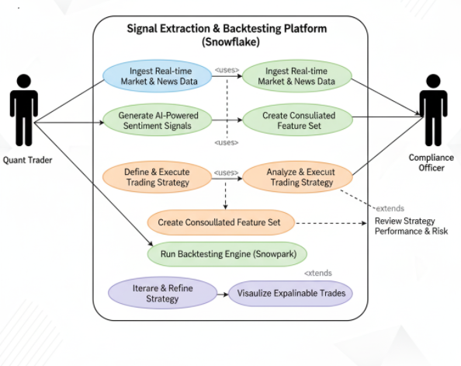
Process fiow diagram or Use-case diagram

Slide 6
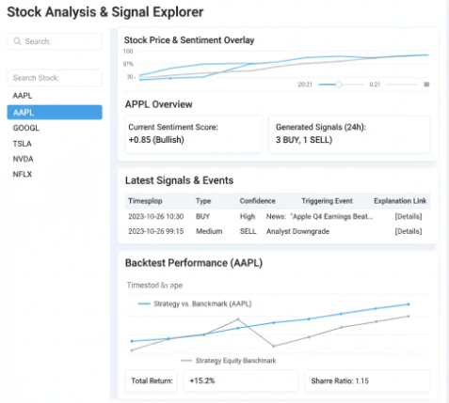
Wireframes/Mock diagrams of the proposed solution (optional)

Slide 7
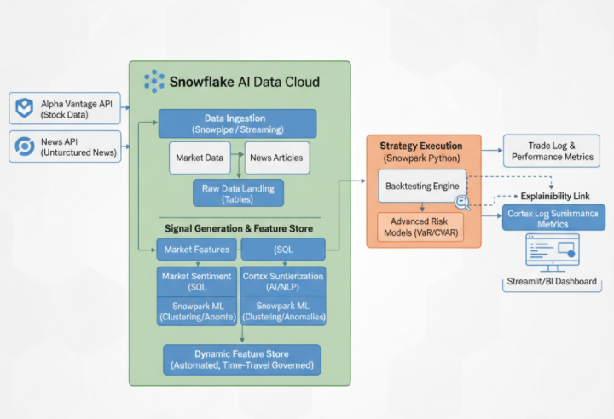
Architecture diagram of the proposed solution

Slide 8
Technologies to be used in the solution
Snowflake Core Platform: The single, secure, and infinitely scalable environment for all data and processing.
Snowpipe / Streaming: Automates the low-latency loading of all stock and news data from external APIs.
Snowflake Cortex AI: Provides native, scalable NLP and SENTIMENT() analysis directly on news text.
Dynamic Tables: Automates feature set refresh and enforces data governance to mitigate look-ahead bias.
Snowpark for Python: The framework for building and executing the complex backtesting and financial models inside the warehouse.
Snowpark ML (Advanced): Used for advanced analysis like clustering news themes and detecting sentiment anomalies.

Slide 9
Estimated implementation cost (optional)
The overall estimated monthly cost for a Production Proof-of-Concept (POC) ranges from $1,060 to $1,560, primarily driven by compute usage in Snowflake :
Snowflake Compute Costs: $710 per month. This covers the variable cost of running the Snowpark back testing engine and the consumption-based charges for Snowflake Cortex AI to analyze news sentiment.
External API Subscriptions: $350 – $850 per month. This covers the monthly fees for high-volume, real-time data access from APIs like News API and Alpha Vantage.

Slide 10
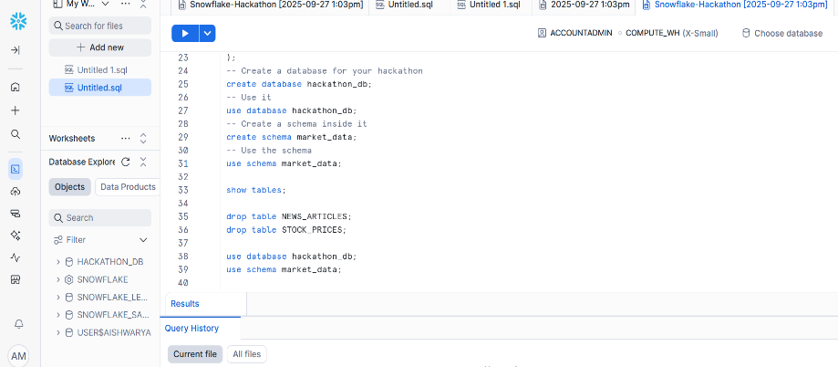
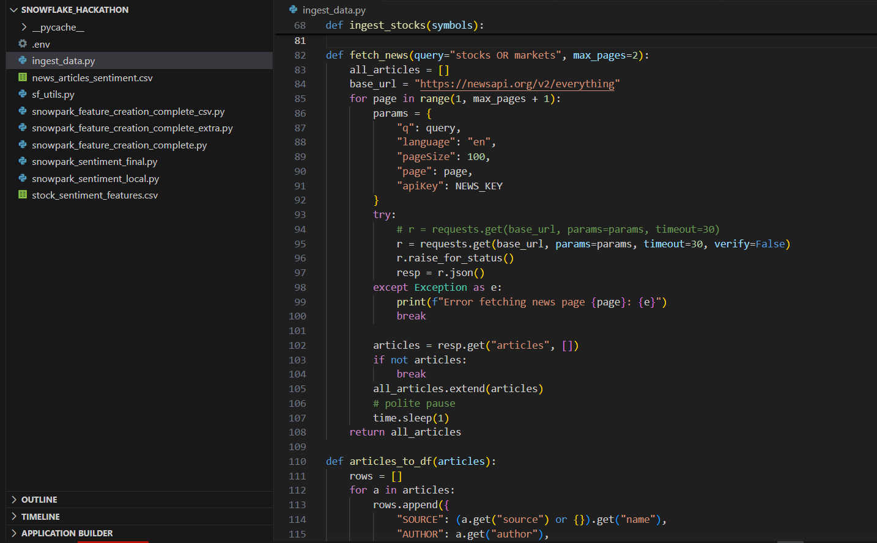
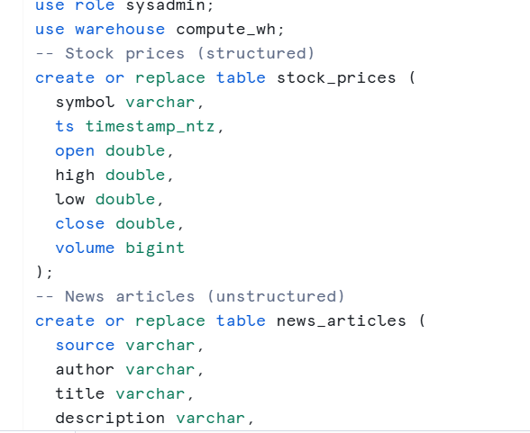
Creating database and accessing tables inside them
Snapshots of the prototype
Data ingestion into snowflake
Creating table schema in snowsight

Slide 11
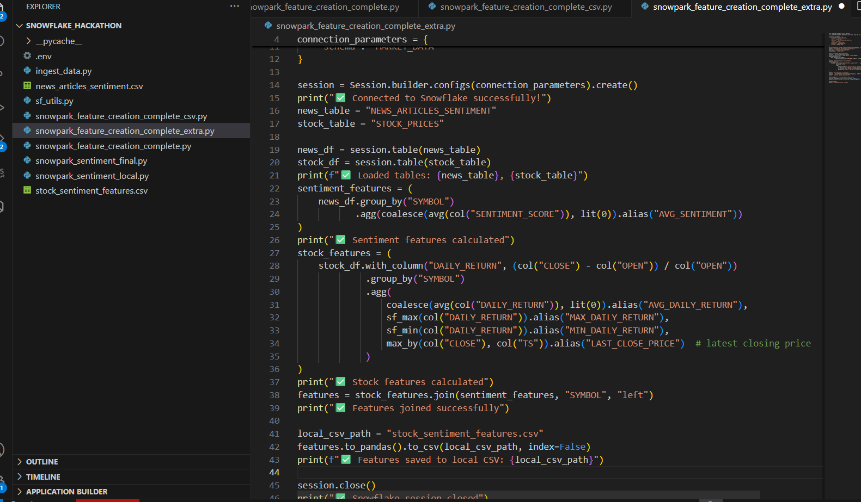
Prototype Performance report/Benchmarking
Since for now, cortex access is not given and this has been done using the trail account, connected snowflake locally and used Snowpark to do the sentiment analysis

Slide 12
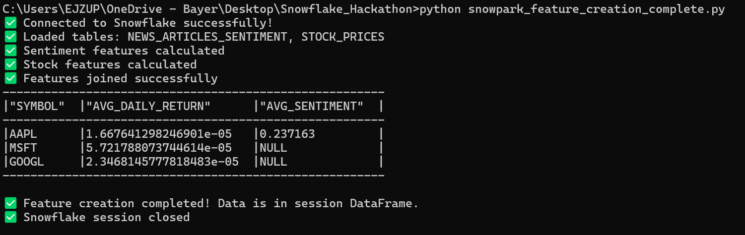
Additional Details/Future Development (if any)
So far worked on sentiment analysis & creating feature sets without the Cortex AI. Further would want to carry out the analysis with cortex and product advanced & accurate results

Slide 13
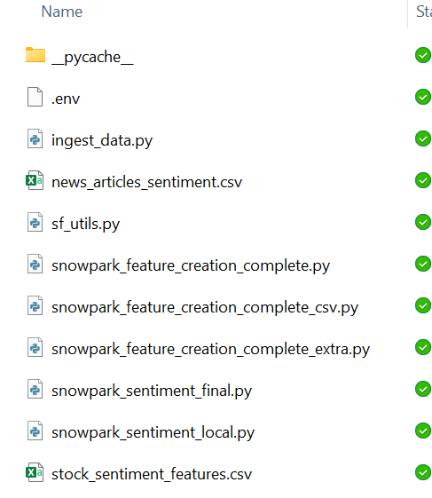
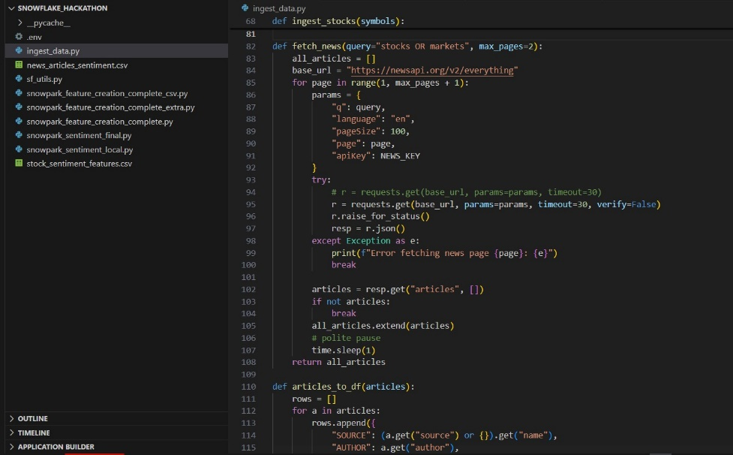
Provide links to your:
File structure created in each step and the results are stored locally in the csv files as for trail account, there was no access to create a new table
Process of given datasets ingestion into snowflake using their resp API

Slide 14
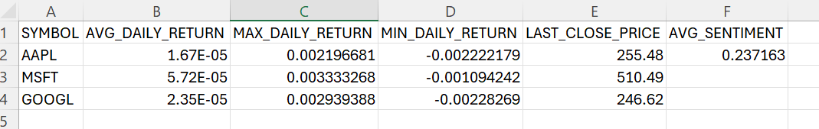
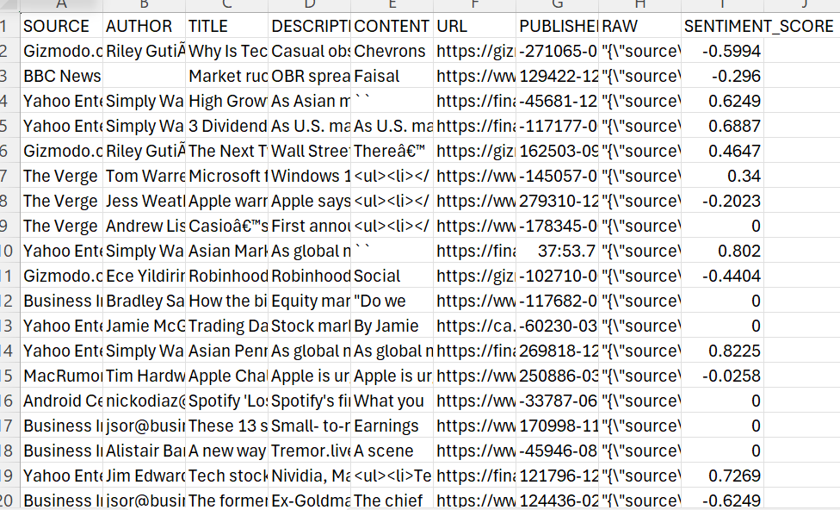
These are the references of the outputs produced which are still under process, but in the first analysis using the sentiment analysis & creating feature sets for signal extraction.

Slide 15
Thank you

